Slide 1
LASER PIANO
Deac Melinda-Anca

Slide 2
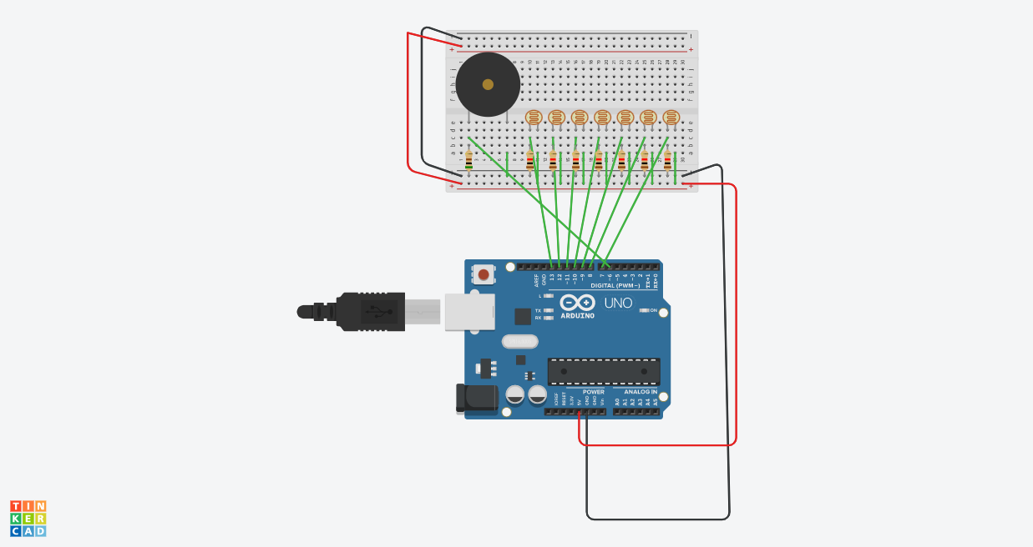
The scheme

Slide 3
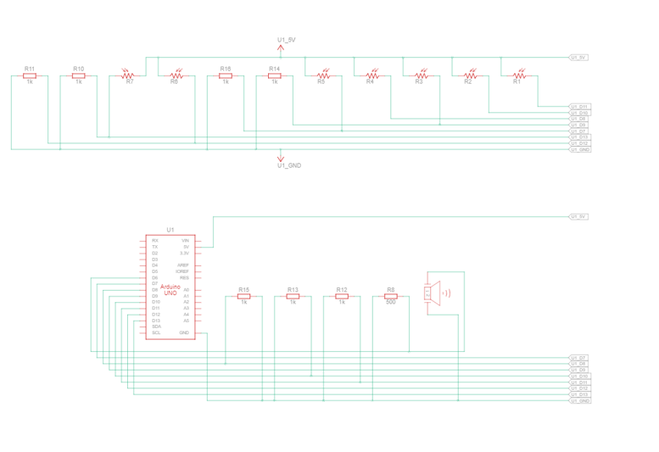
Electrical scheme

Slide 4
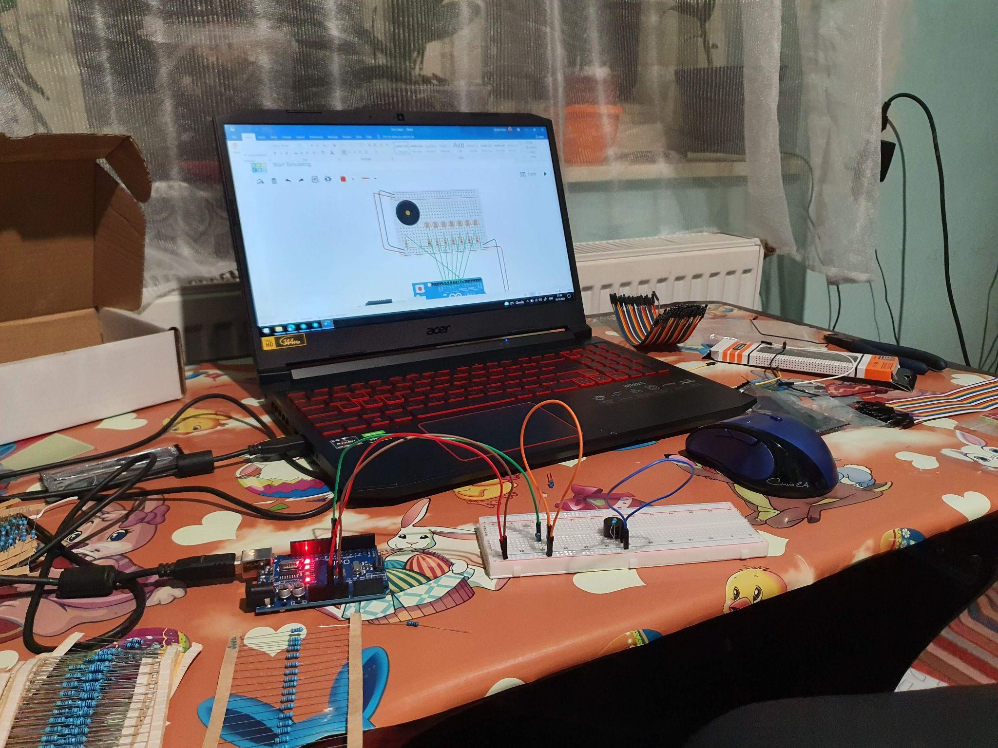
First time working

Slide 5
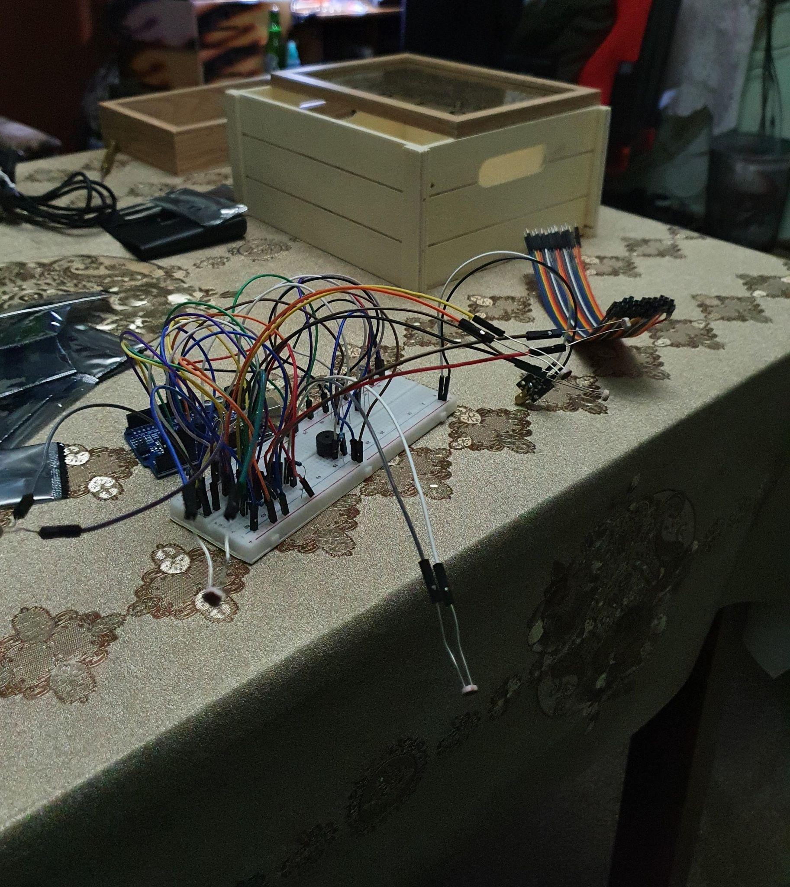
Still working

Slide 6
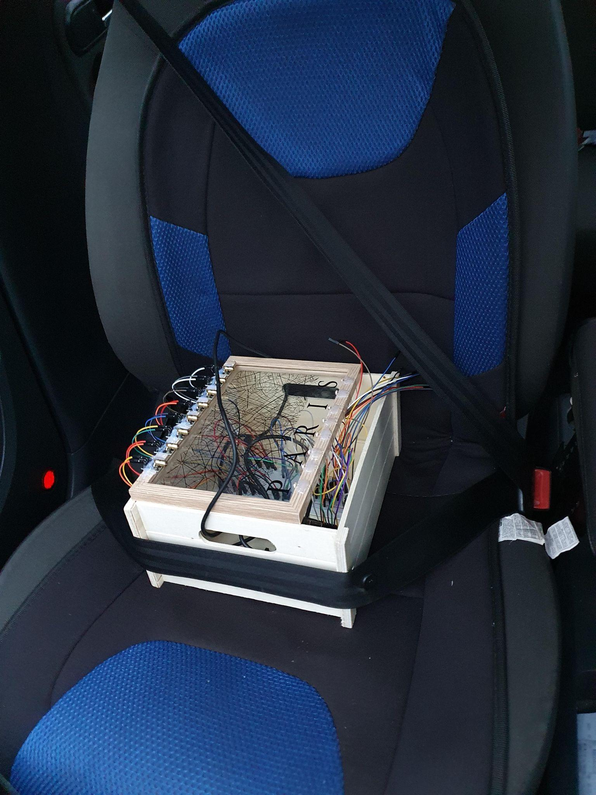
Taking it home

Slide 7
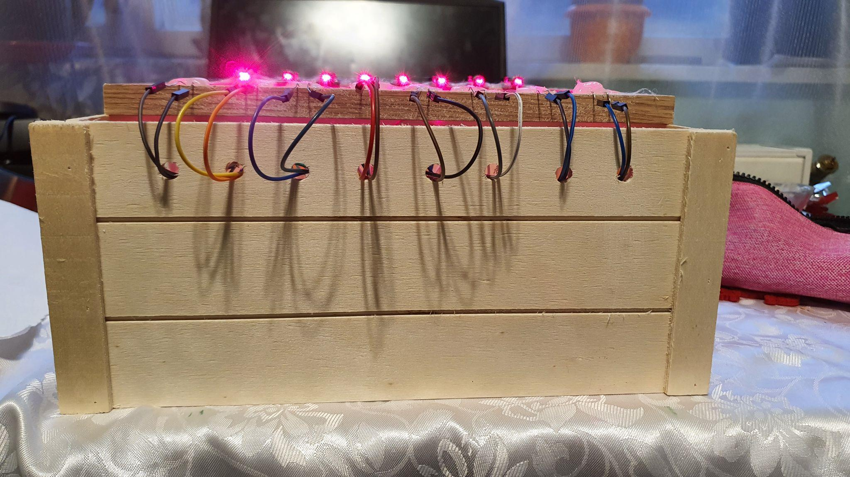
Aesthetics

Slide 8
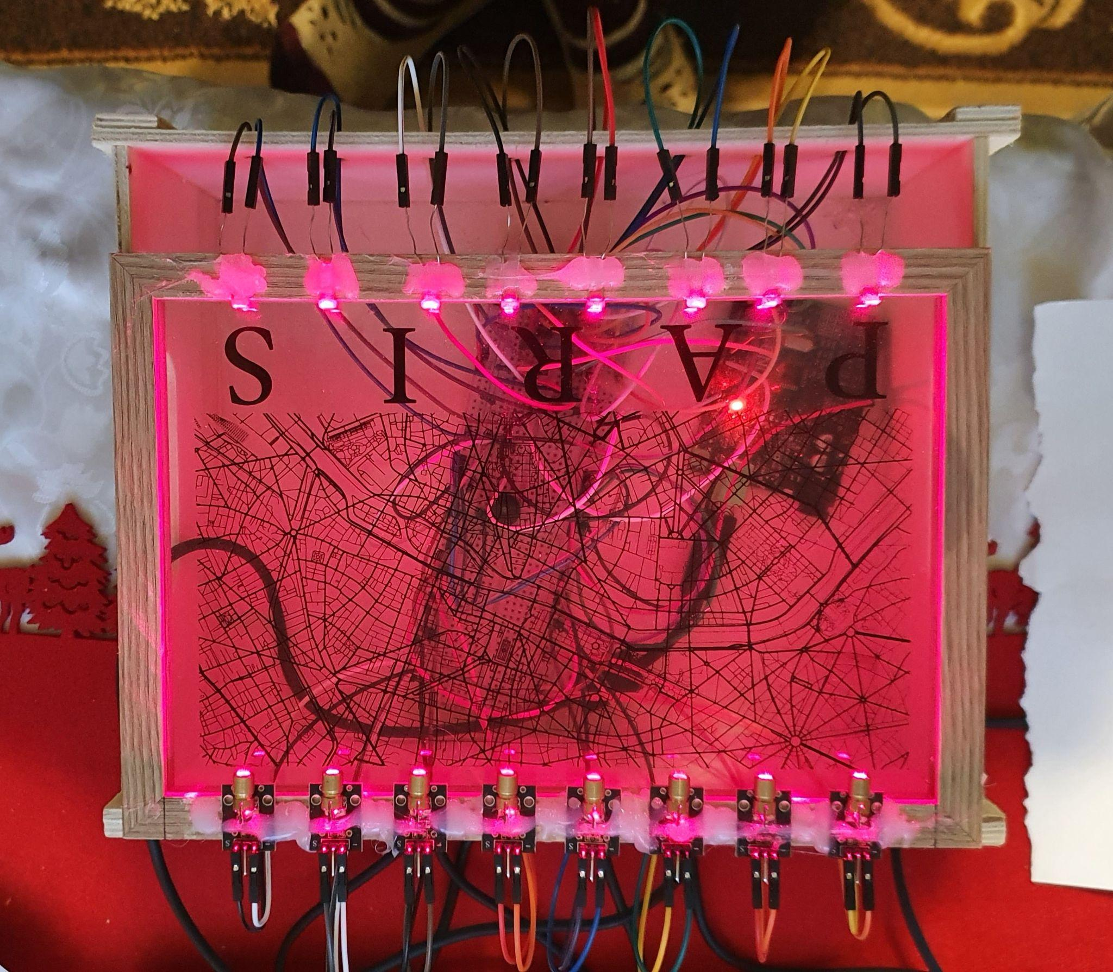
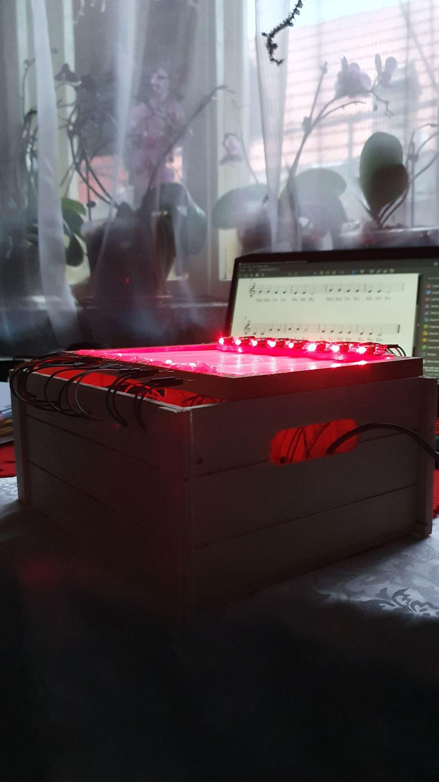
Final product

Slide 9
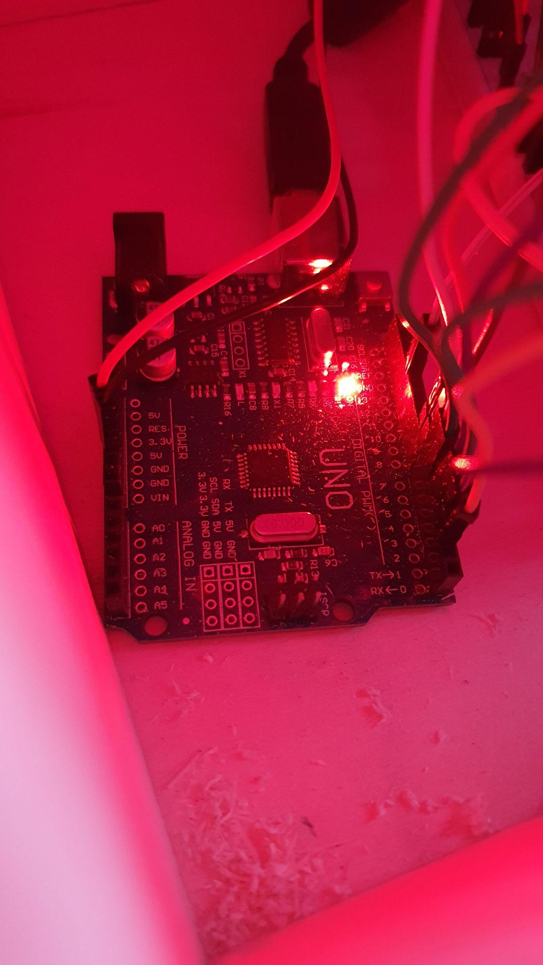
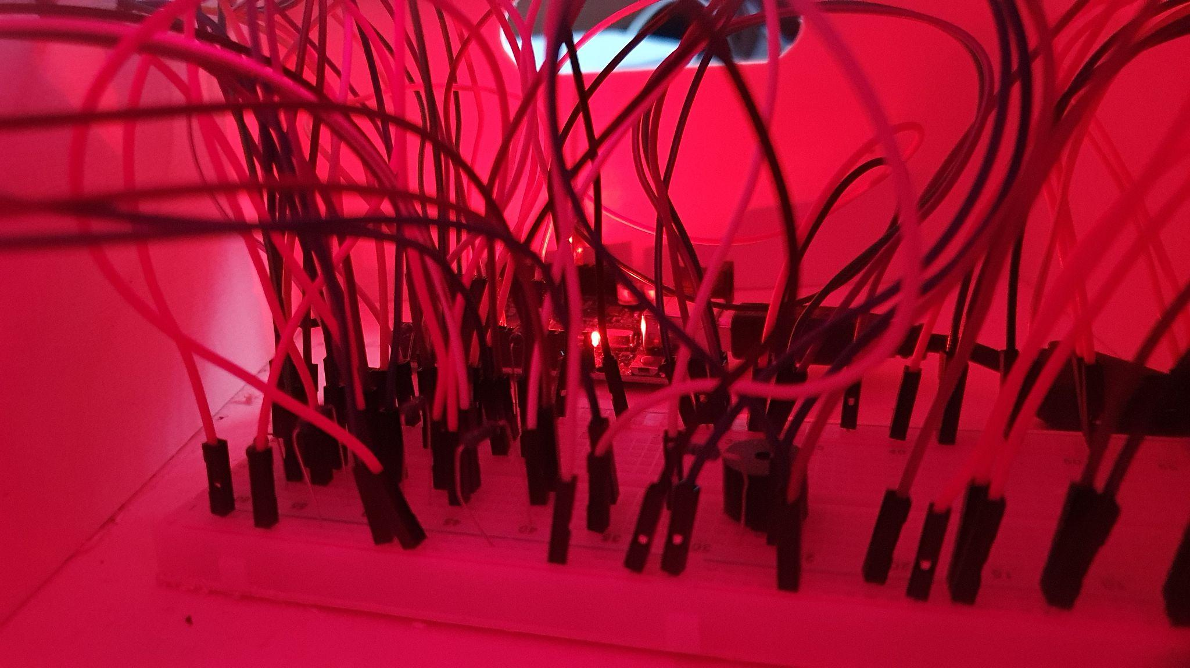
take a look inside

Slide 10
Some code
void setup() {
// put your setup code here, to run once:
pinMode(2, INPUT);
pinMode(3, INPUT);
pinMode(4, INPUT);
pinMode(5, INPUT);
pinMode(6, INPUT);
pinMode(7, INPUT);
pinMode(8, INPUT);
pinMode(9, INPUT);
Serial.begin(9600);
pinMode(13, OUTPUT);
}
DO = digitalRead(2);
RE = digitalRead(3);
MI = digitalRead(4);
FA = digitalRead(5);
SOL = digitalRead(6);
LA = digitalRead(7);
TI = digitalRead(8);
DO1 = digitalRead(9);
if(DO == 1) {
//Serial.println("Laser");
}
else {
Serial.println("DO");
tone(13, 523, 300);
}
if(RE == 1) {
//Serial.println("Laser");
}
else {
Serial.println("RE");
tone(13, 587, 300);
}
if(MI == 1) {
//Serial.println("Laser");
}
else {
Serial.println("MI");
tone(13, 659, 300);
}

Slide 11
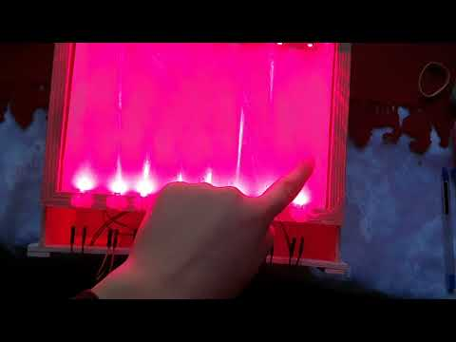
Test

Slide 12
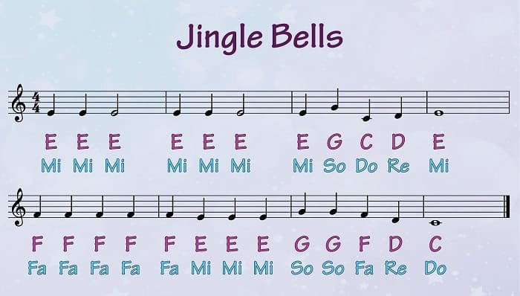
Jingle bells

Slide 13
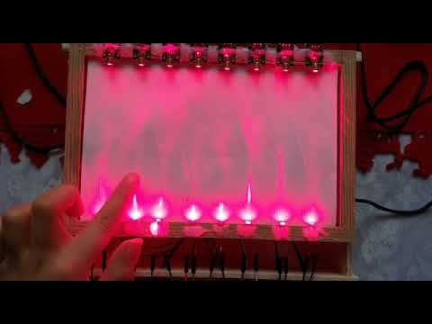
Jingle bells on the piano

Slide 14
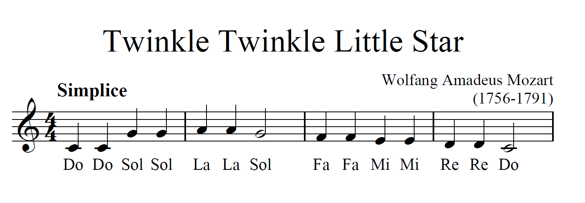
Twinkle-Twinkle Little Star

Slide 15
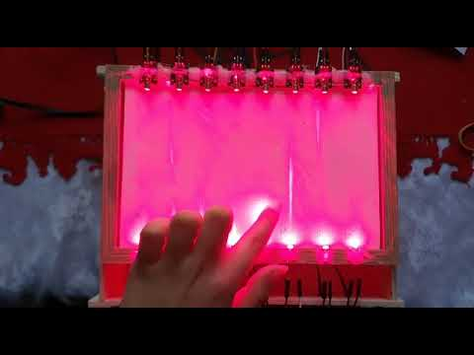
Twinkle-Twinkle Little Star On the piano

